Slide 1
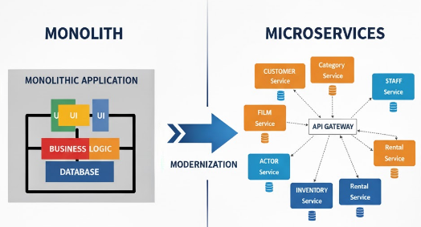
Modernizing Monolith
From Monolith to Microservices: A Strategic Modernization Approach

Slide 2


Current System Analysis
Architecture
Monolithic Spring Boot application
Microservices Architecture
Single codebase with tightly coupled components
Monolithic Architecture
Traditional MVC pattern with Thymeleaf templates
User Interface
User Interface
Database
APIMGateway
Business Layer
Actor Service
Customer Service
MySQL with Sakila schema
Normalized database modeling DVD rental store
Data Layer
Order service
Inventory Service
Complex relationships between films, actors, and rentals
Rental Service
User Service
User Roles
Visitor: Browse films and actors
Customer: Rent films, view account
Owner: Full CRUD access, admin functions

Slide 3


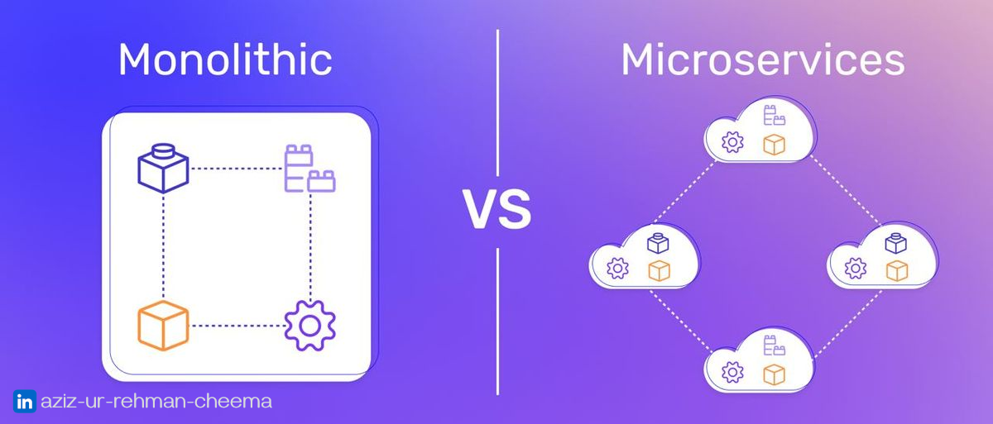

Target Architecture
Microservices Decomposition
Actor Service: Actor profiles, filmography
Customer Service: User accounts, authentication
Film Service: Film catalog, details, search
Rental Service: Rental transactions, inventory
Payment Service: Billing, transactions
Technology Stack
Backend: Node.js
Database: PostgreSQL for relational, MongoDB for document storage
Communication: REST APIs, GraphQL for complex queries
Cloud-Native Services
APIM/Gateway: Central entry point, routing, rate limiting
Service Mesh: Istio for inter-service communication
Containerization: Docker with Kubernetes orchestration
Observability: Prometheus, Grafana, distributed tracing

Slide 4

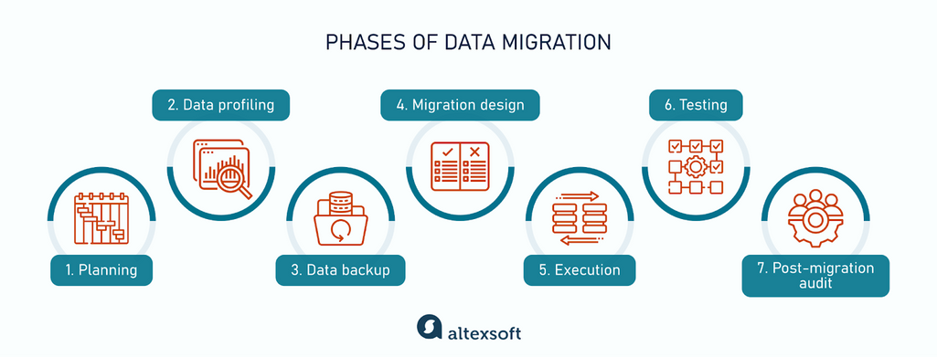


Data Migration Strategy
Migration Phases
Phase 1: Assessment & Planning
Phase 2: Schema Migration
Phase 3: Functional Testing
Phase 4: Performance Testing
Phase 5: Data Migration
Phase 6: Cutover & Validation
Database Transformation
MySQL → PostgreSQL: Relational data (customers, rentals)
MySQL → MongoDB: Document data (films, actors)
Data Validation: Schema mapping, integrity checks
Change Data Capture (CDC)
Real-time Sync: Debezium for streaming changes
Dual-Write Pattern: Write to both systems during transition
Conflict Resolution: Last-write-wins strategy

Slide 5

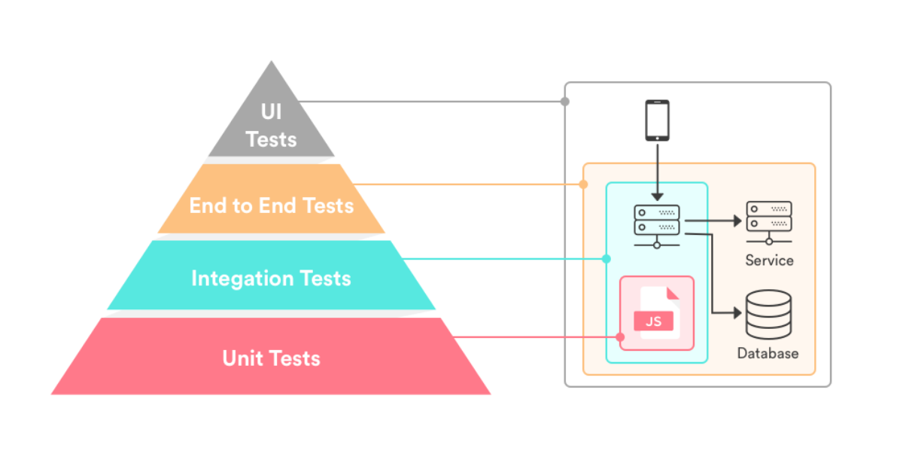

Testing Strategy
Testing Pyramid
Unit Tests: 70% - Fast, isolated service tests
Integration Tests: 20% - Service interactions
E2E Tests: 10% - Full user journeys
Contract Testing
Pact: Consumer-driven contract testing
API Specifications: OpenAPI/Swagger validation
Mock Services: Service virtualization
Deployment Strategy
Dual-Write: Parallel operation during transition
Canary Releases: Gradual traffic shifting
A/B Test: Gradual customer base shifting
Feature Flags: Controlled feature rollout
Rollback Plan: Automated fallback triggers

Slide 6


Rollout Plan
Dual-Write Strategy
Phase 1: Write to both monolith & microservices
Phase 2: Read from microservices, write to both
Phase 3: Full microservices operation
Key Milestones
Cutover Approach
1
Service Isolation: Extract film service
2
Parallel Operation: Dual-write implementation
Canary Releases: 5% → 25% → 50% → 100%
Feature Flags: Toggle new functionality
3
API Gateway: Central routing layer
Gradual Migration: Service by service
4
Data Migration: Database transition
Rollback Plan
5
Full Cutover: Complete microservices
Automated Triggers: Performance thresholds
6
Decommission: Legacy system retirement
Manual Override: Emergency stop button
Data Consistency: Synchronization checks

Slide 7
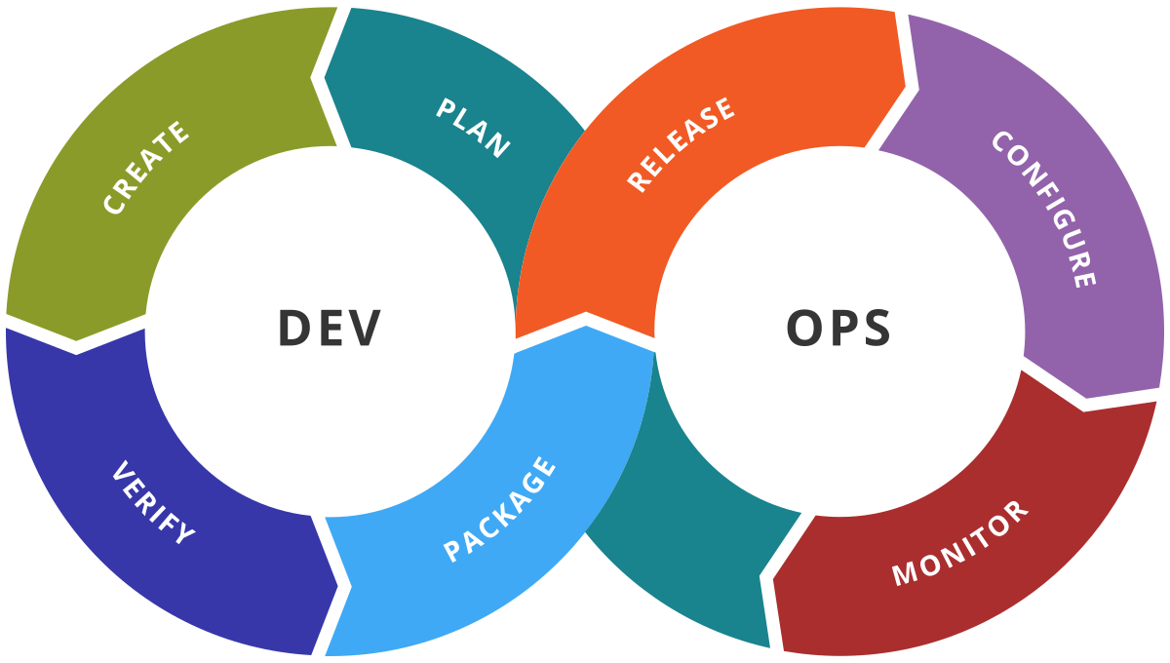


Team & Execution
Key Roles
Solution Architect: Design & technical decisions
Backend Developers: Node.js/NestJS implementation
DevOps Engineers: CI/CD & infrastructure
QA Engineers: Testing & quality assurance
Database Specialists: Migration & optimization
Timeline & Phases
1
2
3
4
Planning
Foundation
Migration & Testing
Cutover
2 weeks
4 weeks
6 weeks
2 weeks
DevOps Toolchain
CI/CD: Jenkins, GitHub Actions
Containerization: Docker, Kubernetes
Monitoring: Prometheus, Grafana
Infrastructure: Terraform, AWS/Azure

Slide 8







Summary and Next Steps
Modernization Approach
Strategic Decomposition: Domain-driven microservices
Technology Evolution: Node.js with cloud-native services
Data Migration: Phased approach with CDC synchronization
Immediate Next Actions
Risk Mitigation: Dual-write strategy with gradual cutover
1
Form Cross-Functional Team: Assign key roles
2
Technical Deep Dive: Analyze current codebase
Key Benefits
3
Proof of Concept: Extract first microservice
Improved Performance
Enhanced Scalability
4
Infrastructure Setup: CI/CD pipeline
Easier Maintenance
Faster Development
5
Stakeholder Alignment: Secure project approval

